Slide 1
Environmental Impacts of Artificial Turf Fields
CHE - Alaska
September 18, 2024
Susan D. Chapnick, M.S.
President & Principal Scientist, NEH, Inc.
Arlington, MA Conservation Commissioner
Notes:
Many towns and cities across the US, and especially in my home state of MA, are currently involved in evaluating Artificial Turf Field projects, maintenance, and replacement in and around wetland resource areas and squarely in urban environments.
Recently in the past few years, several towns in the Northeast (including Concord, Sharon, & Wayland), have issued or are considering moratoriums on installation of ATFs.
Knowledge of Artificial Turf Fields and the science of potential impacts and the current information on the environment can help municipalities make more informed decisions.

Slide 2
Artificial Turf Field - Components
Notes:
From Town of Arlington – Artificial Turf Forum, May 2023

Slide 3
Environmental Chemical Concerns
Toxic Metals including Lead and Zinc
Polyaromatic hydrocarbons (PAHs)
PFAS Per- and Poly-fluoroalkyl Substances
Plastic Chemicals – phthalates & bisphenol A
Over 350 chemicals identified in EPA literature review for tire crumb rubber; confirmed presence of hazardous chemicals that are known carcinogens & neurotoxicants
6ppd-quinone from oxidized tire crumb rubber
Microplastics
Notes:
Chemical hazards escape from artificial turf surfaces to the environment.
A number of the chemical components of artificial turf are soluble in water – when rain and snow fall on synthetic fields, these chemicals can leach to contaminate surface waters, groundwaters, and soil – other chemicals can migrate with the particles.
6ppd-quinone – explain that will discuss findings for this chemical in the section on how artificial turf affects habitat and wildlife
Studies to assess the chemical safety of artificial turf are ongoing
Recent studies including one conducted by Mount Sinai and the Toxic Use Reduction Institute (TURI) found the presence of known carcinogens and neurotoxins including polycyclic aromatic
hydrocarbons (PAHs), lead, zinc, and black carbon in almost all alternative infill materials examined
Sources: EPA July 2019: Tire Crumb Rubber Characterization https://www.epa.gov/chemical-research/july-2019-report-tire-crumb-rubber-characterization-0
Massey et al. New Solut. 2020 May; 30(1):10-26. doi: 10.1177/1048291120906206
Armada et al. 2022. “Global evaluation of the chemical hazard of recycled tire crumb rubber employed on worldwide synthetic turf football pitches,” Science of the Total Environment, v812, 15 Mar 2022,152542 https://www.sciencedirect.com/science/article/pii/S0048969721076208
6ppd-quinone: https://pubs.acs.org/doi/10.1021/acs.estlett.2c00050

Slide 4
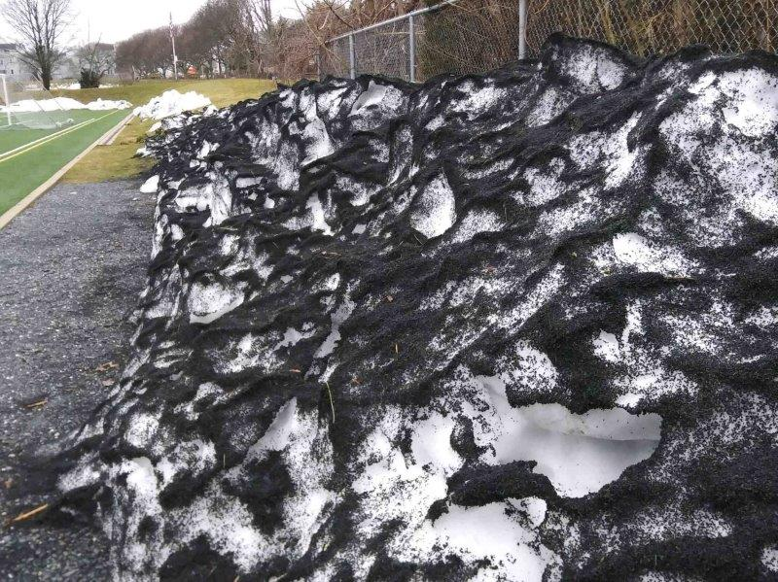
Tire Crumb Rubber Infill
Tires:
Natural & synthetic rubber – fossil fuel sources
Fillers
Additional Chemicals = Antioxidants, antiozonants, vulcanization compounds
Artificial Turf Field, Arlington, MA 2021
Photo credit: S. Chapnick
Notes:
Approximately 260 million waste tires (4.5 million tons) in 2019 . (US Tire Manufacturers Association, “2019 U.S. Scrap Tire Management Summary,” 2020.)
Tire crumb Bottom picture is from the Arlington Catholic Artificial Turf field on Summer St, taken winter 2021 – the black on the snow pack is all crumb rubber infill
Alternate infills – discussed at a previous CHE webinar

Slide 5
Chemical Concerns - PFAS
Per- and polyfluoroalkyl substances (PFAS)
  Class of almost 15,000 “forever” chemicals
  Used in the manufacturing of turf carpet grass blades and backing
  Linked to environmental and human health problems
New England communities have found PFAS in artificial turf
Complexity in Interpreting Test Results
  Target compounds: e.g., PFOS, PFOA, PFHxS, PFPeA, PFHxA, PFHpA, etc.
  Compound classes: Total Fluorine / Total Organic Fluorine / Total Organic Precursors
Lowell Center for Sustainable Production, UMass-Lowell, July 2024. Per- and Poly-fluoroalkyl Substances (PFAS) in Artificial Turf: Test Methods. https://www.uml.edu/docs/PFAS-in-turf-Test-methods-July%202024_tcm18-385224.pdf
Notes:
A chemical group of concern in artificial turf fields is the perfluoroalkyl and polyfluoroalkyl substances (PFAS).
6 PFAS are currently regulated in MA in DW, GW, and soil.
Testing specifications EPA method 1633 (January 2024 for > 30 compounds) and not just the 6 PFAS currently regulated – because the number and type of PFAS chemicals of concern is a moving target. Recent PFAS-free certification standards (GreenScreen Certified) for both firefighting foams and food packaging have specified total elemental fluorine testing.
Consider leachate tests as well as testing the new material. Synthetic Precipitation Leaching Procedure (SPLP) EPA Method 1311
Weathering from sun, rain, abrasion will potentially change what chemicals are released from the material
NJDEP Technical Memorandum on PFAS in Artificial Turf: https://dep.nj.gov/wp-content/uploads/dsr/pfas-artificial-turf-memo-2023.pdf
References: Lowell institute Aug 2024 PFAS in artificial turf https://www.uml.edu/docs/PFAS%20in%20Artificial%20Turf%20-%20Academic%20Municipal%20%26%20Other%20Tests%20Aug%202024_tcm18-386957.pdf

Slide 6
Chemical Concerns - PFAS
RIDEM / RIDOH – Burriville, RI
  Artificial Turf installed 2007 / replaced in 2021
  Upgradient Well = non-detect for PFAS-6
  Downgradient Well = ~ 20-30 ng/L
  Downgradient Well in June 2024 = 61 ng/L
  RI Groundwater Quality Standard = 20 ng/L
“RIDOH and RIDEM are most concerned about the potential for PFAS from the turf field to contaminate groundwater in the area.”
Letter to Burrillville Town Council from the RI Department of Environmental Management and the RI Department of Health, August 15, 2024
https://www.burrillville.org/sites/g/files/vyhlif2886/f/uploads/doh_dem_letter_with_response_from_trc_1.pdf

Slide 7
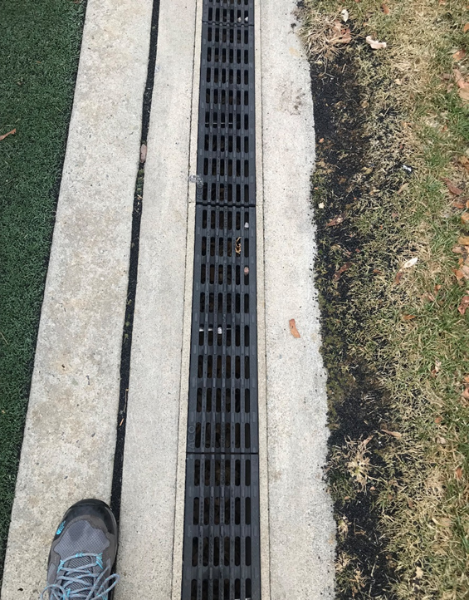
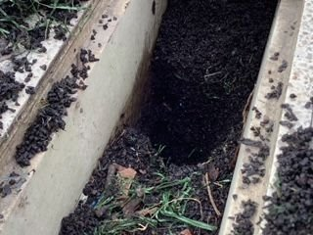
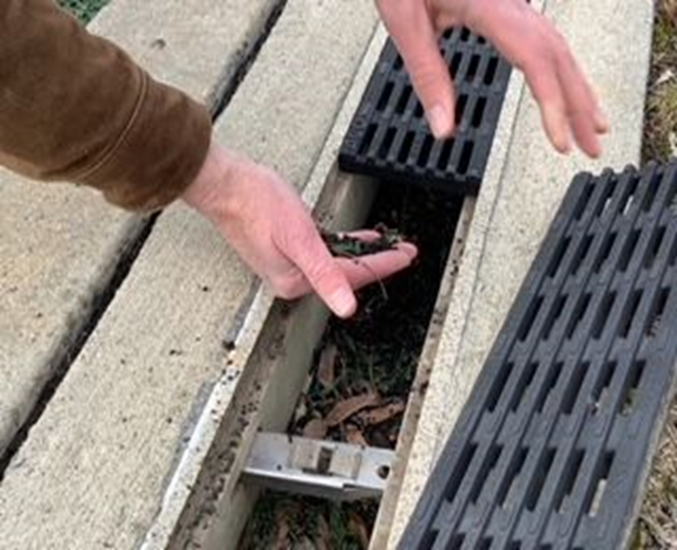
Fields Shed Infill &
Weathered, Broken Plastic Blades
Arlington Catholic Turf Field, 2022
Photo: S. Chapnick
Notes:
Most of the scientific studies are on tire crumb rubber infill. This is still the most common infill for artificial turf fields due to cost and age of existing fields. Not as much research on alternate infills.
Why is this a concern? Fields shed infill and weathered / degraded plastic blades.
These pictures show migration of infill and broken plastic blades off of a 10 year old artificial turf field – shedding tire crumb rubber and microplastics into the adjacent upland resource area – which is the 100’ buffer to Mill Brook in Arlington – and shows that these artificial turf field components deposit in perimeter drains and outside of the perimeter drainage system of the field. December 2022

Slide 8
Chemical Concerns: Aquatic Toxicity
Zinc and “whole effluent” toxicity – Exceedance of EPA acute aquatic toxicity criteria
    CT DEEP Artificial Turf Stormwater Study, 2010
    https://portal.ct.gov/-/media/deep/artificialturf/depsummarypdf.pdf
6PPD-quinone – direct toxicity to freshwater fish
  N-(1,3-Dimethylbutyl)-N’-phenyl-p-phenylenediamine = 6PPD
  UV light / oxidation of 6PPD = 6PPD-quinone
  Present in used tires and tire wear particles / tire crumb rubber
Interstate Technology & Regulatory Council (ITRC) Fact Sheet: “What We Know: 6PPD and 6PPD-quinone” July 2023
Notes:
DIRECT impacts from ATF runoff
Surface water runoff from an artificial turf field showed toxicity to aquatic organisms in CT DEP study – based on whole effluent (all of the surface water runoff components) toxicity and evidence of Zinc toxicity.
More recently in 2021 and 2022, the compound 6-ppd quinone, which is an oxidized form of the compound found in used tires, show direct toxicity to salmon and freshwater fish.

Slide 9
Chemical Concerns – 6PPD-Quinone
Urban Runoff Mortality Syndrome – coho salmon 1999-2001
Tian et al. 2021 linked fish kills to 6PPD-quinone in road runoff
LC50 (50% mortality) in different species ranges from 0.04 ug/L (40 ng/L) to no mortality at 50 ug/L (sockeye salmon)
Coho Salmon = most sensitive species tested to date
Table excerpt from Table 1 in: Interstate Technology & Regulatory Council (ITRC) Fact Sheet: “What We Know: 6PPD and 6PPD-quinone” July 2023
Species | LC50 (ug/L) | Test Duration (h)
Coho salmon | 0.04 for hatchlings; 0.08 adult | 24
White-spotted char | 0.51 | 24
Brook trout | 0.59 | 24
Notes:
Tian et al in 2021 first linked 6PPD-Q to fish kills – acute mortality to coho salmon
Subsequent peer-reviewed scientific papers reported acute toxicity of 6ppd-q to other fish and documented environmental occurrences.
Acute Toxicity of the Tire Rubber-Derived Chemical 6PPD-quinone to Four Fishes of Commercial, Cultural, and Ecological Importance. https://pubs.acs.org/doi/10.1021/acs.estlett.2c00050

Slide 10
Chemical Concerns – 6PPD-Quinone
EPA Acute Freshwater Aquatic Life Screening Values
  Federal Register, June 2024
https://www.federalregister.gov/documents/2024/06/13/2024-13009/acute-aquatic-life-screening-values-for-6ppd-and-6ppd-quinone-in-freshwater
Runoff: Artificial Turf pitch with tire crumb rubber infill = 159 ng/L [Kryuchkov et al. (2023). Presence of 6PPD-quinone in runoff water samples from Norway using a new LC-MS/MS Method. Front. Environ. Chem. 4:1194664]
Acute Freshwater Aquatic | 6PPD | 6PPD-Quinone
Screening Values | 8,900 ng/L (ppt) | 11 ng/L (ppt)
Duration | 1h | 1h
Frequency | Not to be exceeded more than once in 3 years
Notes:
Tian et al in 2021 first linked 6PPD-Q to fish kills – acute mortality to coho salmon
Subsequent peer-reviewed scientific papers reported acute toxicity of 6ppd-q to other fish and documented environmental occurrances.
Acute Toxicity of the Tire Rubber-Derived Chemical 6PPD-quinone to Four Fishes of Commercial, Cultural, and Ecological Importance. https://pubs.acs.org/doi/10.1021/acs.estlett.2c00050
EPA has published in Federal Register in June 2024 Acute Freshwater Aquatic Life Screening Values for 6PPD and 6PPD-quinone under the Clean Water Act, section 304(1)(2)(B), for the protection of aquatic life.
States and Tribes may use these screening values in water quality protection programs. The acute freshwater aquatic life screening values are in table

Slide 11
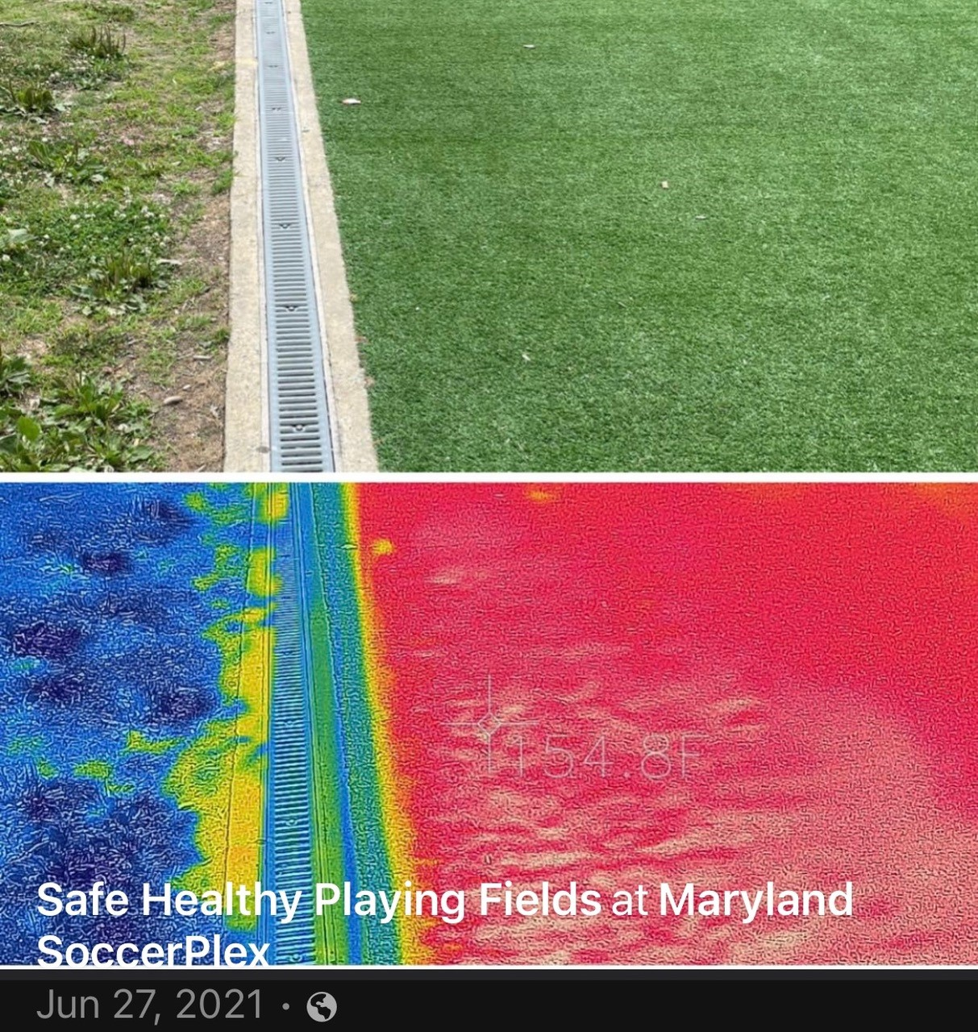
Heat
Alaska Stormwater Guide
Warm water runoff from impervious surfaces are harmful to salmon and other cold water species.
154.8 F
Notes:
Cold fisheries are harmed by warm water discharges.
Water discharges from ATF have the potential to impact cold fisheries due to heat.
The Alaska Stormwater Guide from 2011 lists “Temperature” as one of the stormwater concerns in Table 1-3
“Warm water runoff from impervious surfaces are harmful to salmon and other cold water species.”

Slide 12
Regulations & Policies
Federal – Clean Water Act; Acute Freshwater Aquatic Life Values
State and Local regulations & policies
  Wetlands
  Stormwater management
  Climate adaptation and resilience
  Plastic proliferation / microplastics
  Sustainability / Recycling
Local Watershed Associations
  Charles River Watershed Assoc. opposes installation of ATF https://www.crwa.org/artificial-turf
Alaska Stormwater Guide
  https://dec.alaska.gov/water/wastewater/stormwater/resources/guidance/
Notes:
Knowledge of Artificial Turf Fields and the science of potential impacts and the current information on heat stress and climate impacts can help municipalities make more informed decisions – are ATF’s consistent with these regulations
In MA, Conservation Commissions have jurisdiction to implement the state Wetlands Protection Act and in some cases, as with my town of Arlington, local Bylaws and regulations that are stricter than the state. The WPA protects wetland areas and buffer zones and “values” or interests, which I present on a subsequent slide. This gives regulatory leverage to evaluating ATF in these areas.
CRWA – good website resource
Alaska Stormwater Guide – stormwater pollution prevention includes guidance on toxic contaminants such as heavy metals, pesticides/herbicides, dioxin, oil/gas, etc.

Slide 13
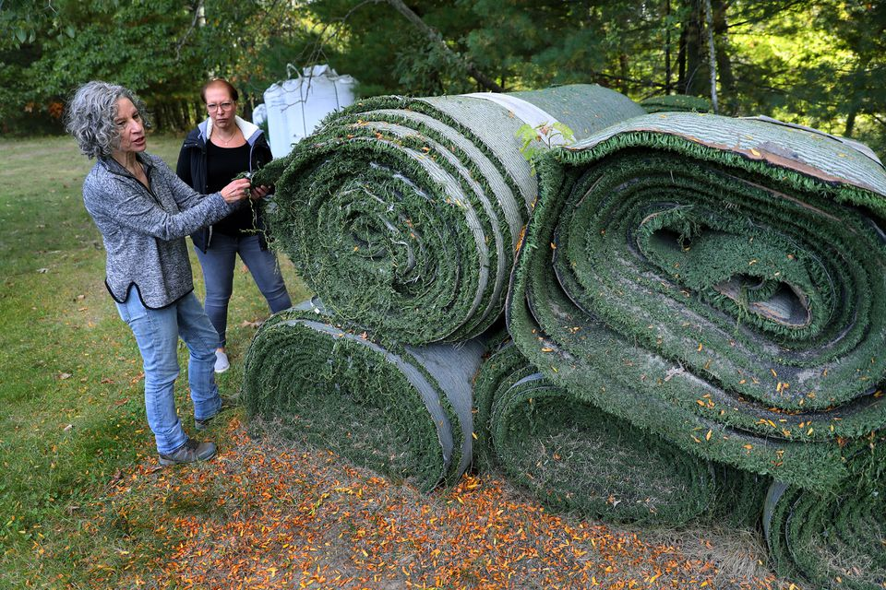
Environmental Impacts on Climate Resilience
Excess Heat
Loss of Carbon Sequestration
Incineration & “chemical recycling” = pollution
Fossil Fuel Consumption/Use
Limited useful lifespan - 10 yrs
Piles of Artificial Turf in Franklin, MA. David L. Ryan / Globe Staff 2019
Notes:
According to the Synthetic Turf Council, one 80,000 sq ft athletic field uses 200 Tons (400,000 lbs.) of infill and has 20 Tons of Turf Carpet. Current evidence shows that artificial turf cannot be meaningfully recycled. Synthetic Turf Council “Guide to Recycle, Reuse, Repurpose, and Remove Synthetic Turf Systems” 2017 states “the carbon footprint of a particular recycling/end-of-life option (such as trucking long distances) may be integrated into the decision-making process and lead responsible parties to invalidate such an option. It is important to investigate all recycling and reuse options in the region before choosing to landfill.”
The hope has been that the products of “advanced / chemical recycling” could be used to make new plastics, replacing some of the need for virgin fossil sources. - “advanced recycling” or chemical recycling uses pyrolysis to decompose plastics at elevated temperatures in an oxygen-free or low-oxygen environment cause the plastics to de-polymerize. The products of pyrolysis are low-value fuels (syngas, pyrolysis oil, and char), as well as CO and H. Variability in feedstock of plastics poses challenges and makes this not viable - in its current form simply contributes to chemical pollution and does not produce new durable plastic products.
Artificial turf contributes to the climate crisis throughout its lifecycle, requiring fossil fuels during production and emitting greenhouse gases during use and disposal - Adds to plastic proliferation - Artificial turf fields are not consistent with sustainability principals in that they have a limited lifespan of approximately 10 years at which time they need to be disposed of and replaced.
Reference: Ted Schettler, MD, MPH, Science Director, Science and Environmental Health Network, CHE (Collaborative for Health & Environment), “Advance Recycling” of Plastics: Largely waste disposal by another name (Part 1) and (Part 2), October & November 2023

Slide 14
Artificial Turf Fields Alter Wetlands
Pollution
  Chemical hazards in run-off
  Particulate / Plastic & Microplastic migration
Groundwater & Surface water impacts
Wildlife Habitat impacts
  Loss of habitat for insects and other invertebrates
  Loss of habitat for foraging for birds and small mammals
  Loss of wildlife corridor connectivity – disrupted habitats
  Heat effects on habitat & potential heated stormwater runoff
Biodiversity impacts
Notes:
My focus area = Wetlands and Climate change resilience
Wetlands regulations protect values of the wetlands including Protection of wildlife, wildlife habitat, aquatic species and their habitats – ecological functions of the wetlands – CONSIDER: are ATF consistent with these protections and values?
Chemical hazards including Zinc other metals, PAHs, PFAS, and most recently discovered 6PPD-quinone escape from artificial turf surfaces to the environment – including plastic and particulate migration
CUMULATIVE adverse effects on Wetland resources and values
PLASTIC IS NOT HABITAT
A typical 80,000 sq ft athletic field places 80,000 sq ft of plastic in the environment, which contributes to a significant loss of habitat for insects and other invertebrates, loss of habitat for foraging, and loss of wildlife corridor connectivity
NY Freshwater Wetlands Protection Act: Biological Diversity - 6NYCCR Part 663, 664, & 665

Slide 15
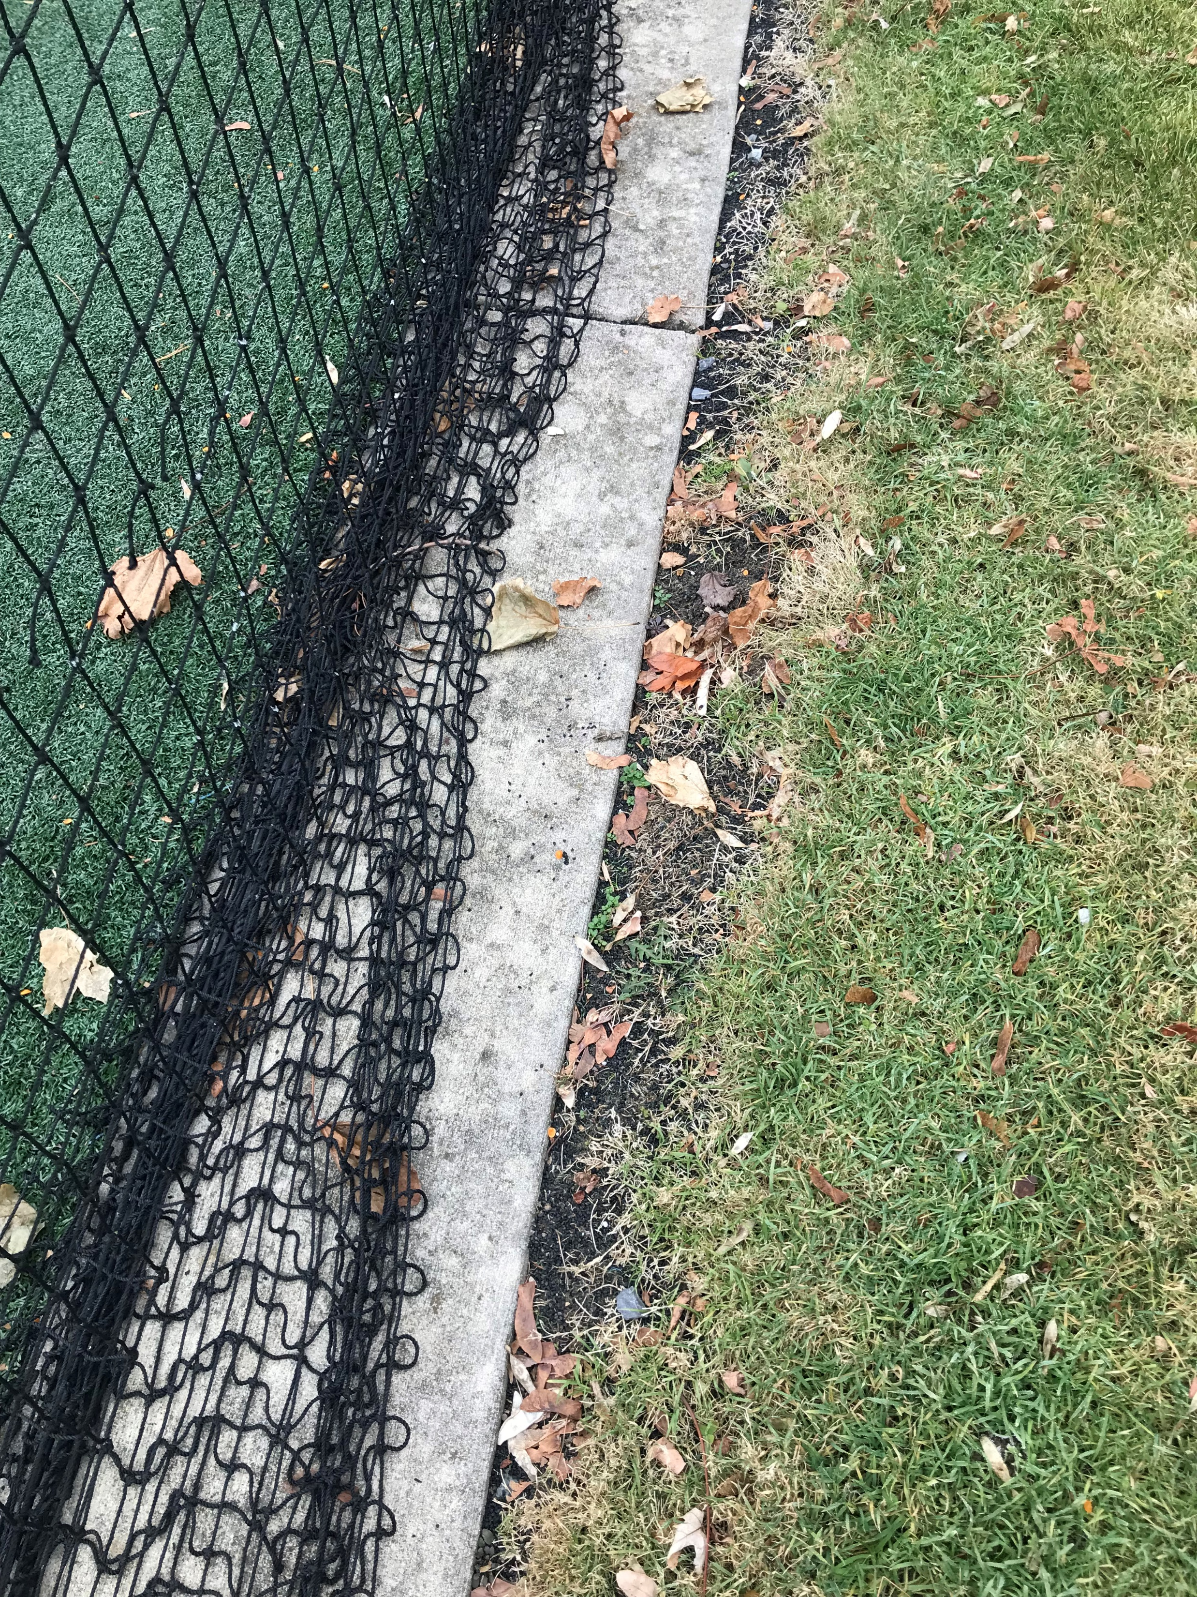
Town of Arlington, MA
Artificial Turf Study Committee –
Final Report, April 2024
https://www.arlingtonma.gov/home/showpublisheddocument/69732/638494836316530000
Conclusion
Artificial turf fields can be an option “(a) after careful evaluation of the practicality and feasibility of natural turf options, and (b) with proper health and environmental safeguards in place.”
Tire Crumb Rubber Infill
Migration into resource area
[photo credit: Chapnick 2022]
Notes:
The adverse impacts on wetlands and climate change resilience in my town, as well as evidence that older fields are showing real impacts - Picture on right show migration of tire crumb rubber infill off of an ATF in Arlington; This field is within protected wetland buffer area – led me to propose to the Arlington Conservation Commission that they consider prohibiting the use of artificial turf in wetland jurisdictional areas due to adverse affects that I documented. The Commission held a public discussion of the environmental impacts of artificial turf at its January 5, 2023 meeting, which prompted the Town Manager to propose a temporary moratorium on funding, permitting, and construction of ATF and was the impetus for a Town-wide forum on ATF with a panel of experts on Human Health, Environmental, and Safety issues.
Link to the video recording – quite contentious. Artificial Turf Forum, May 2023
https://www.arlingtonma.gov/Home/Components/News/News/12938/3972?backlist=%2ftown-governance%2fboards-and-committees%2fconservation-commission

Slide 16
Municipality / Community Considerations for Artificial Turf Athletic Fields
Excess Heat
Lifecycle costs
Location – wetland resources
Habitat loss / Biodiversity loss
Climate impacts / sustainability
Practical alternative – Organic or Sustainably managed Natural Grass Sports Field
https://www.youtube.com/watch?app=desktop&v=E3FEO7vmuCE
Maryland 5/30/2024
Notes:
Heat – urban heat islands and impacts to cold water fisheries
Cost over 20+ years – real costs of installation, maintenance, replacement – Artificial Turf Athletic Fields are ~ 2x natural turf fields over 20 years (considering 2 AT replacements)
Location – impacts due to chemical pollution & microplastic / particulate pollution; location proposed in an area already impacted by urban heat – will exacerbate local heat concerns / or environmental justice concerns with open space, for example
Habitat loss / biodiversity
Climate resilience impacts
Alternative = natural turf field – well-constructed for drainage and use; organic or sustainable turf management to lessen need for chemical fertilizers / no pesticides

